Slide 1


GOJAN SCHOOL OF BUSINESS AND TECHNOLOGY
EDAPALAYAM, REDHILLS, CHENNAI-52.
Approved by A.I.C.T.E, New Delhi, Affiliated to Anna University, Chennai. (NAAC Accredited& An ISO 9001:2015 Certified Institution)
DEPARTMENT OF COMPUTER SCIENCE AND ENGINEERING
Project Title: Secure Web Hosting with HTTPS on Microsoft Azure
BATCH - 4
BATCH MEMBERS
SURESH KUMAR.D (110521104049)
VIMALESH.C (110521106303)
YOGESH BALAJI.K (110521104058)
RAMA KRISHNAN.A (110521104032)
UNDER THE GUIDANCE
Mrs ANJALI. S M.E. ( AP/CSE)

Slide 2
Problem Statement
In today’s fast-paced digital world, traditional systems often struggle to meet the growing demands of efficient information access, secure data handling, and real-time user interaction. Many existing solutions lack centralized access, automation, and a modern user interface, leading to inefficiencies, data inconsistency, and poor user experience. There is a need for a comprehensive platform that can provide streamlined operations, user-friendly interaction, and reliable data processing in a secure, scalable environment. The absence of dynamic web applications capable of offering seamless access, advanced features such as real-time monitoring, role-based access control, and integration with cloud services hinders operational efficiency in various domains. This project aims to bridge that gap by developing a secure, visually enhanced application, hosted on a virtual server, offering an advanced, interactive solution tailored to meet modern digital expectations.

Slide 3
Objective
To architect and deploy a secure and scalable web hosting environment utilizing the Microsoft Azure platform.
To seamlessly enable HTTPS for the hosted web application by leveraging Azure’s Managed SSL certificates, ensuring automatic renewal and simplified management.
To fortify the application’s security posture through the strategic implementation of Azure Web Application Firewall (WAF) to mitigate application-layer vulnerabilities and DDoS Protection to defend against volumetric denial-of-service attacks.
To optimize the web application’s global accessibility and performance by strategically employing Azure Front Door for intelligent traffic routing and enhanced content delivery.

Slide 4
SCOPE OF THE PROJECT
Enable HTTPS to ensure encrypted and secure communication.
Use Azure CDN for faster global content delivery and SSL support.
Custom domain integration for a professional web presence with GoDaddy (project25.life).
Implement security principles and load balancing
Scalable and cost-effective
DDoS Protection to defend against volumetric denial-of-service attacks
Implementation of Azure Web Application Firewall to mitigate application-layer vulnerabilities.

Slide 5
Literature Survey
Related Works: Many systems currently employ traditional methods for resource management with limited automation and poor User Interfaces. Technologies Studied: Secure web application development with automated SSL. HTML5, CSS3, and JavaScript for frontend. SSL/TLS for secure communication. Improvement Over Existing Systems: Unlike conventional systems, our solution is highly secure, cloud-compatible, and optimized for real-time response.

Slide 6
Existing system
Manual SSL/TLS management: Certificates must be installed and renewed on each server, increasing the risk of expiration and misconfiguration.
Limited scalability: As traffic grows, manual intervention is often required to add or configure more servers.
Poor security posture: Without integrated firewalls or security monitoring, applications remain vulnerable to a wide range of attacks.
No intelligent routing: Traditional systems route traffic based on IP or port, with no ability to make content-based routing decisions.
Lack of centralized control: Security, performance, and monitoring tools are often spread across multiple platforms and services, making management inefficient.

Slide 7
proposed system
Secure HTTPS Hosting: SSL/TLS termination at the Application Gateway enables encrypted communication between clients and the server. Centralized certificate management simplifies renewal and reduces the risk of misconfiguration.
Web Application Firewall (WAF):Integrated WAF protects the application from common web attacks such as SQL injection, cross-site scripting (XSS), and other OWASP Top 10 vulnerabilities.Security policies can be customized and updated regularly.
Intelligent Traffic Management: URL-based routing allows specific paths (e.g., /api, /admin) to be routed to different backends if needed. Session affinity and health probes ensure reliable user sessions and application uptime.
Scalability and High Availability: The Application Gateway supports autoscaling based on demand, ensuring consistent performance during traffic spikes.
Monitoring and Diagnostics:Azure Monitor and Application Gateway diagnostics provide real-time visibility into traffic patterns, security logs, and performance metrics.

Slide 8
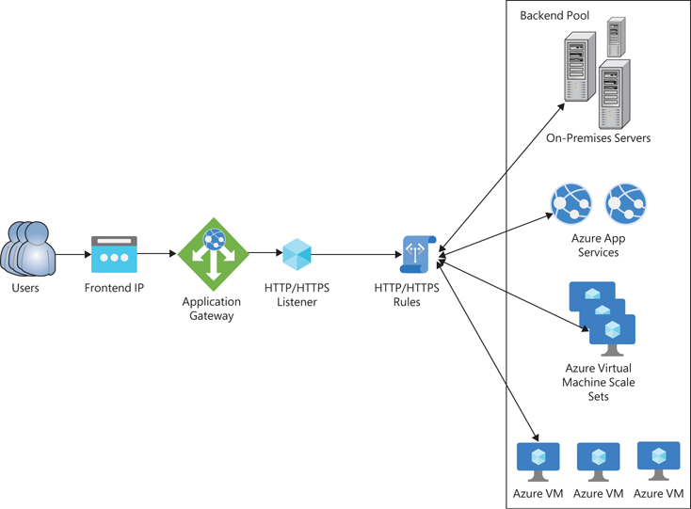
Proposed Architecture Diagram

Slide 9
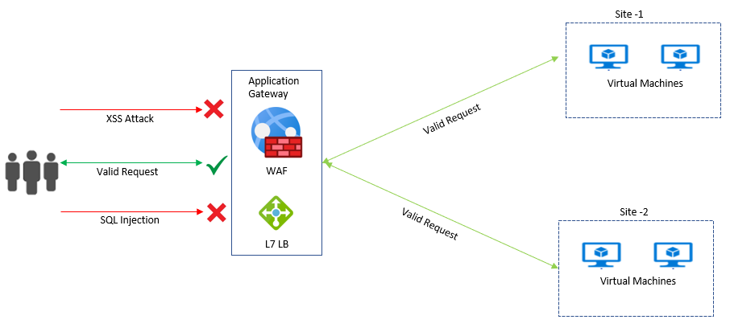
Implementing Web Application Firewall (WAF)

Slide 10
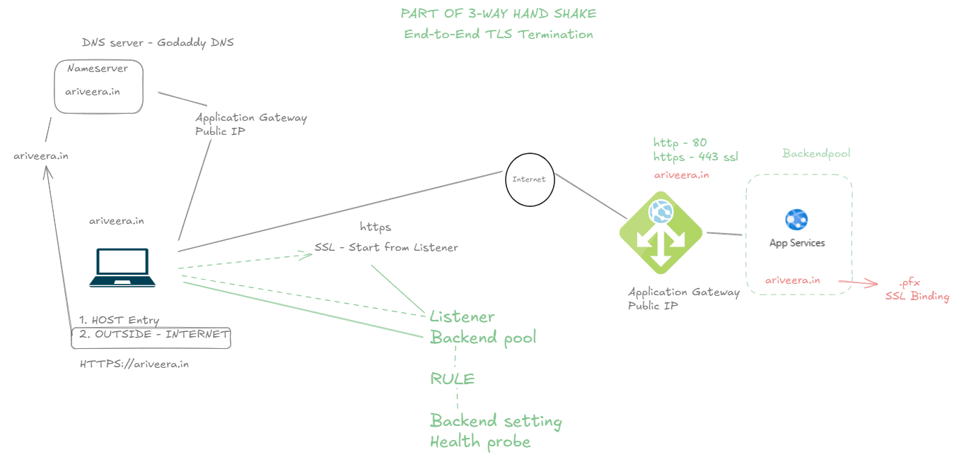
Three-way Handshake diagram

Slide 11
Technology Stack
Operating System: Windows Server 2016 (VM-based setup for manual deployment and security configurations)
Languages: HTML, CSS, JavaScript (for frontend),PowerShell (for automation and Windows-based scripting)
Web & App Technologies: Azure App Service with IIS (Internet Information Services for deployment)
Security & Networking: SSL for encryption,Azure Web Application Firewall (WAF),Azure DDoS Protection,Azure Front Door (for global load balancing & HTTPS)
Monitoring & Automation: Azure Monitor and Application Insights,Custom PowerShell scripts or Azure Automation for certificate renewal and scheduled audits.

Slide 12
IMPLEMENTATION dETAIL
Core Features Developed:
A virtualized secure hosting environment on Azure VM (Windows Server 2016)
Install the IIS (Web server)
Enabled HTTPS (Port no 443) with Azure Managed Certificates (SSL).
Configured Azure Front Door for global traffic routing and load balancing
Set up WAF policies for OWASP-based threat mitigation and DDoS protection
Built automation scripts for SSL certificate renewal and logging

Slide 13
Iis (web server) installation
IIS INSTALLATION USING POWERSHELL
To install IIS (Internet Information Services) on a Windows Virtual Machine (VM) using PowerShell, these commands can be run directly on the VM.
In Virtual machine overview – Operations - Run Command – RunPowershellscript.
“ import-module servermanager
add-windowsfeature web-server –includeallsubfeature”
IIS INSTALLATION USING SERVER MANAGER
To install IIS (Internet Information Services) on a Windows Virtual Machine (VM) using server manager.

Slide 14
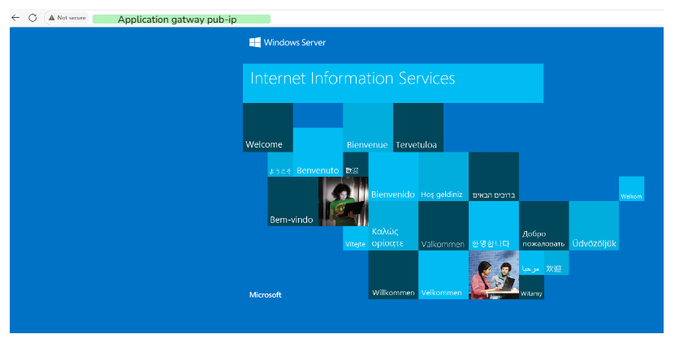
Default iis Output

Slide 15
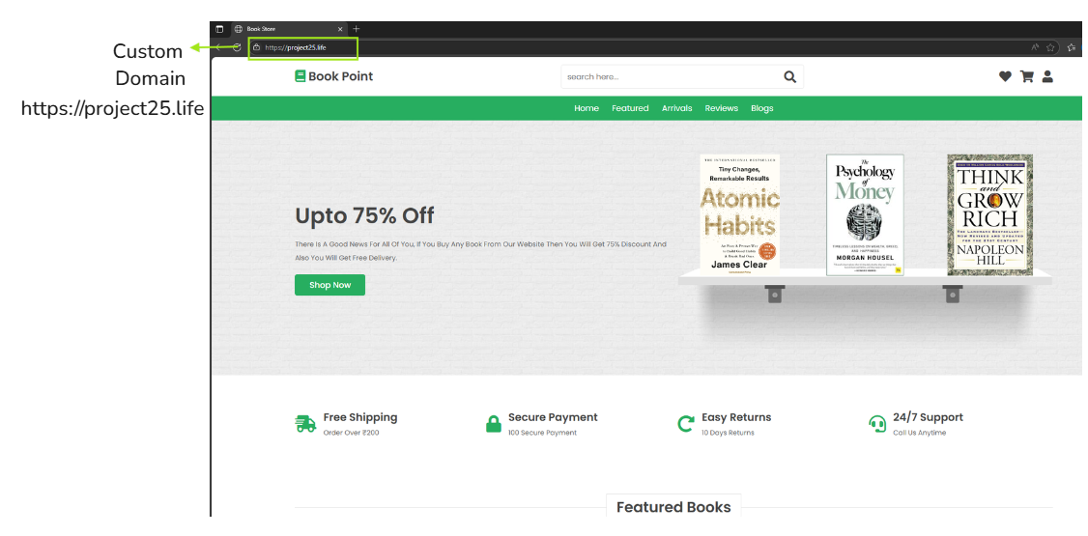
modified Output Screenshot

Slide 16
Result and Testing
Functional Testing:
Confirmed HTTPS padlock with valid certificate
Tested WAF blocking common web attacks (SQLi, XSS)
Performance Evaluation:
Page load tested with online tools (Gtmetrix and Google PageSpeed)
Azure Monitor shows uptime and resource usage.

Slide 17
Challenges faced and solution
Challenges:
Configuring IIS manually on Windows Server for Web app
SSL auto-renewal on a self-managed VM without native Azure App Service
Handling DNS propagation and domain verification
Solutions:
Used IIS reverse proxy for deployment
Scheduled PowerShell scripts or used Win-ACME for SSL renewals
Used Azure DNS or GoDaddy for faster verification with CNAME/A records

Slide 18
Future work & Remaining Tasks
Integrate a full-stack web app with database support
Extend WAF rules to include geofencing and custom bot filtering
Enable Azure Sentinel or Defender for advanced threat analytics
Add user access authentication (e.g., Azure Active Directory)

Slide 19
Conclusion
In conclusion, this project successfully demonstrates the creation of a robust cloud-based web hosting architecture on Microsoft Azure that prioritizes security, operational automation, and optimal performance. By strategically integrating Azure’s comprehensive suite of services, including App Service for hosting, Managed SSL for simplified HTTPS, WAF and DDoS Protection for layered security, and Front Door for enhanced global delivery, the resulting solution offers a reliable, fast, and secure platform for serving web content. This approach effectively addresses common vulnerabilities and complexities associated with conventional hosting environments and presents a scalable and adaptable model for real-world, production-grade web applications.

Slide 20
References
Alok Kumar Pathak et al.,"A Taxonomy of DDoS Attacks on Cloud Computing Environment and Approaches to Mitigation," IEEE, 2025.
Thanapat Thaipakdee et al.,"Scalable Machine Learning Approach for Realtime Detection of XSS Attacks in Web Applications," IEEE, 2025.
Anshul Kumar et al.,"Dynamic Load Balancing for Enhanced Resource Utilization in IaaS Cloud Computing," IEEE, 2024.
T. Sheela et al., “Secure Online Examination System on Azure Cloud,” IEEE ICCCT 2021.
Microsoft Azure Official Documentation (App Service, Front Door, SSL/TLS, WAF)

Slide 21
Thank you

